Slide 1

WorkerNode
private class WorkerNode{
private String name;
private WorkerNode boss;
private WorkerNode peer;
private WorkerNode subordinate;
}

Slide 2
attributes of Office class
manager a WorkerNode reference
current a WorkerNode reference
private WorkerNode manager;
private WorkerNode current;

Slide 3



constructor
create a new WorkerNode object referred to by manager
set manager.name based on parameter
set current to refer to the same object as manager
public Office(String managerName){
this.manager=new WorkerNode();
this.manager.name=managerName;
this.current=this.manager;
}

Slide 4


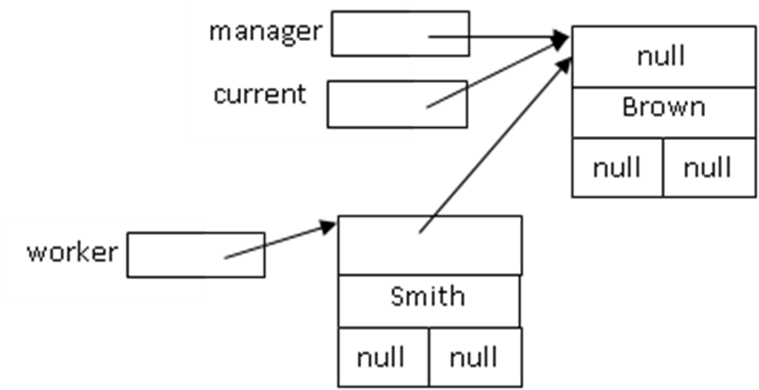
addSubordinate
create a new WorkerNode object referred to by a local reference, worker
set worker.name based on parameter
set worker.boss to refer to the same object as current

Slide 5
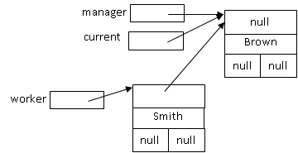

current.subordinate is null
set current.subordinate to worker

Slide 6
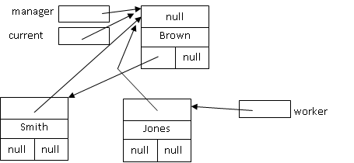
addSubordinate
create a new WorkerNode object referred to by a local reference, worker
set worker.name based on parameter
set worker.boss to refer to the same object as current
current.subordinate is not null

Slide 7
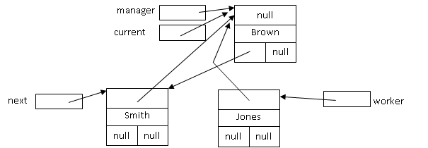
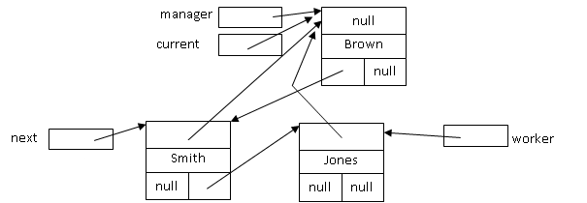
create a WorkerNode reference, next
set next to current.subordinate
next.peer is null
set next.peer to worker

Slide 8
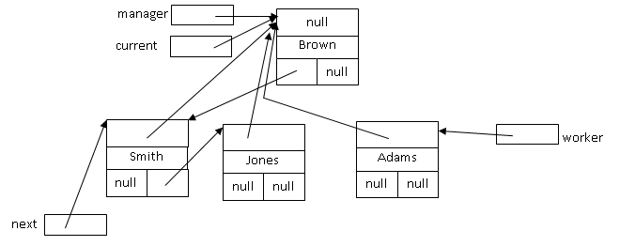
addSubordinate
create a new WorkerNode object referred to by a local reference, worker
set worker.name based on parameter
set worker.boss to current
current.subordinate is not null
create a WorkerNode reference, next
set next to current.subordinate
next.peer is not null

Slide 9


set next to next.peer
next.peer is null
set next.peer to worker

Slide 10
public void addSubordinate(String name){
WorkerNode worker=new WorkerNode();
worker.name=name;
worker.boss=this.current;
if(this.current.subordinate==null)
this.current.subordinate=worker;
else{
WorkerNode next=this.current.subordinate;
while(next.peer!=null)
next=next.peer;
next.peer=worker;
}
}

Slide 11
manager
null
Brown
null
Smith
Jones
Adams
null
null
Carson
Green
Harris
Fergus
null
null
null
null
null

